Slide 1



Slide 2
R for ScHARR
Insert Date
Robert Smith
University of Sheffield &
Dark Peak Analytics
Paul Schneider
University of Sheffield &
Dark Peak Analytics

Slide 3
Time | Section | Comments
XX | Introductions | Chance for everybody to introduce themselves. Teaching team to outline how they use R and why they wanted to be involved in teaching.
XX | Short Presentation | What is R, why is it useful. Some cool examples. Ensure everyone has RStudio downloaded.
XX | Session 1 - BASICS | Led by Rob
XX | Break (10mins) | We strongly recommend getting up and moving around. #movemore
XX | Session 2 - OBJECTS | Led by Rob
XX | Break (10mins) | We strongly recommend getting up and moving around. #movemore
XX | Session 3 – WORKFLOW | Led by Rob
XX | Break (10mins) | We strongly recommend getting up and moving around. #movemore
XX | Presentation & Feedback | How to approach a problem in R, working efficiently and collaborating with others. We are happy to stay on afterwards to answer specific questions.

Slide 4
Introductions

Slide 5
Robert Smith
Background:
Bachelors & Masters in Economics from the University of Nottingham.
PhD Candidate, School of Health & Related Research, Sheffield.
Teaching:
Advanced Simulation Methods (ScHARR HEDM MSc)
Medical Statistics (Sheffield Medical School)
Data Science for Health Economic Evaluation (book).
Research:
Application of health economics to evaluation of interventions to increase population physical activity.
Development of user interfaces for public health economic models.
Advisory work with World Health Organisation & parkrunUK.

Slide 6
Paul Schneider
Background:
Bachelors & Masters in Economics from the University of Nottingham.
PhD Candidate, School of Health & Related Research, Sheffield.
Teaching:
Advanced Simulation Methods (ScHARR HEDM MSc)
Medical Statistics (Sheffield Medical School)
Data Science for Health Economic Evaluation (book).
Research:
Application of health economics to evaluation of interventions to increase population physical activity.
Development of user interfaces for public health economic models.
Advisory work with World Health Organisation & parkrunUK.

Slide 7

Participants
What your background is…
What experience you have with …
Programming
Excel
Statistics
Why you would like to learn R…

Slide 8
Introduction Presentation

Slide 9
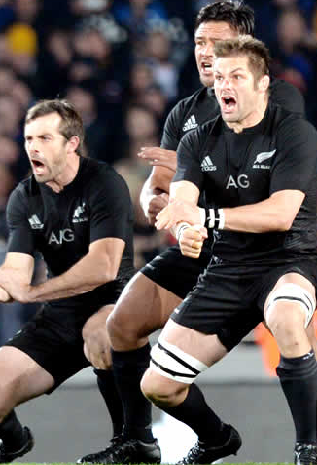

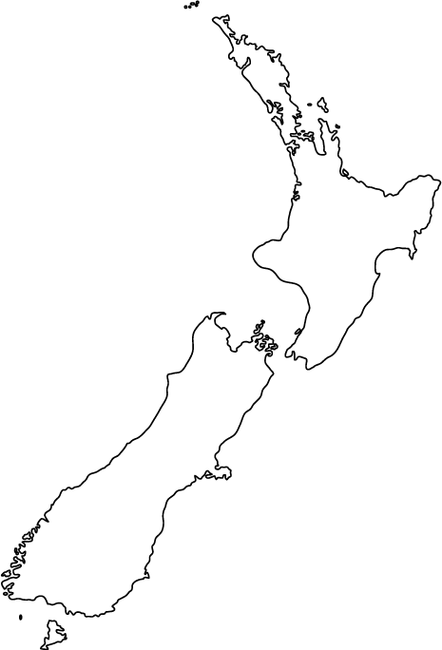


Why learn R?
Programming language & free software environment.
Mainly used for statistical and graphical techniques.
Able to produce fantastic publication-quality plots.
Base-R is good, Base-R + additional packages is awesome.

Slide 10
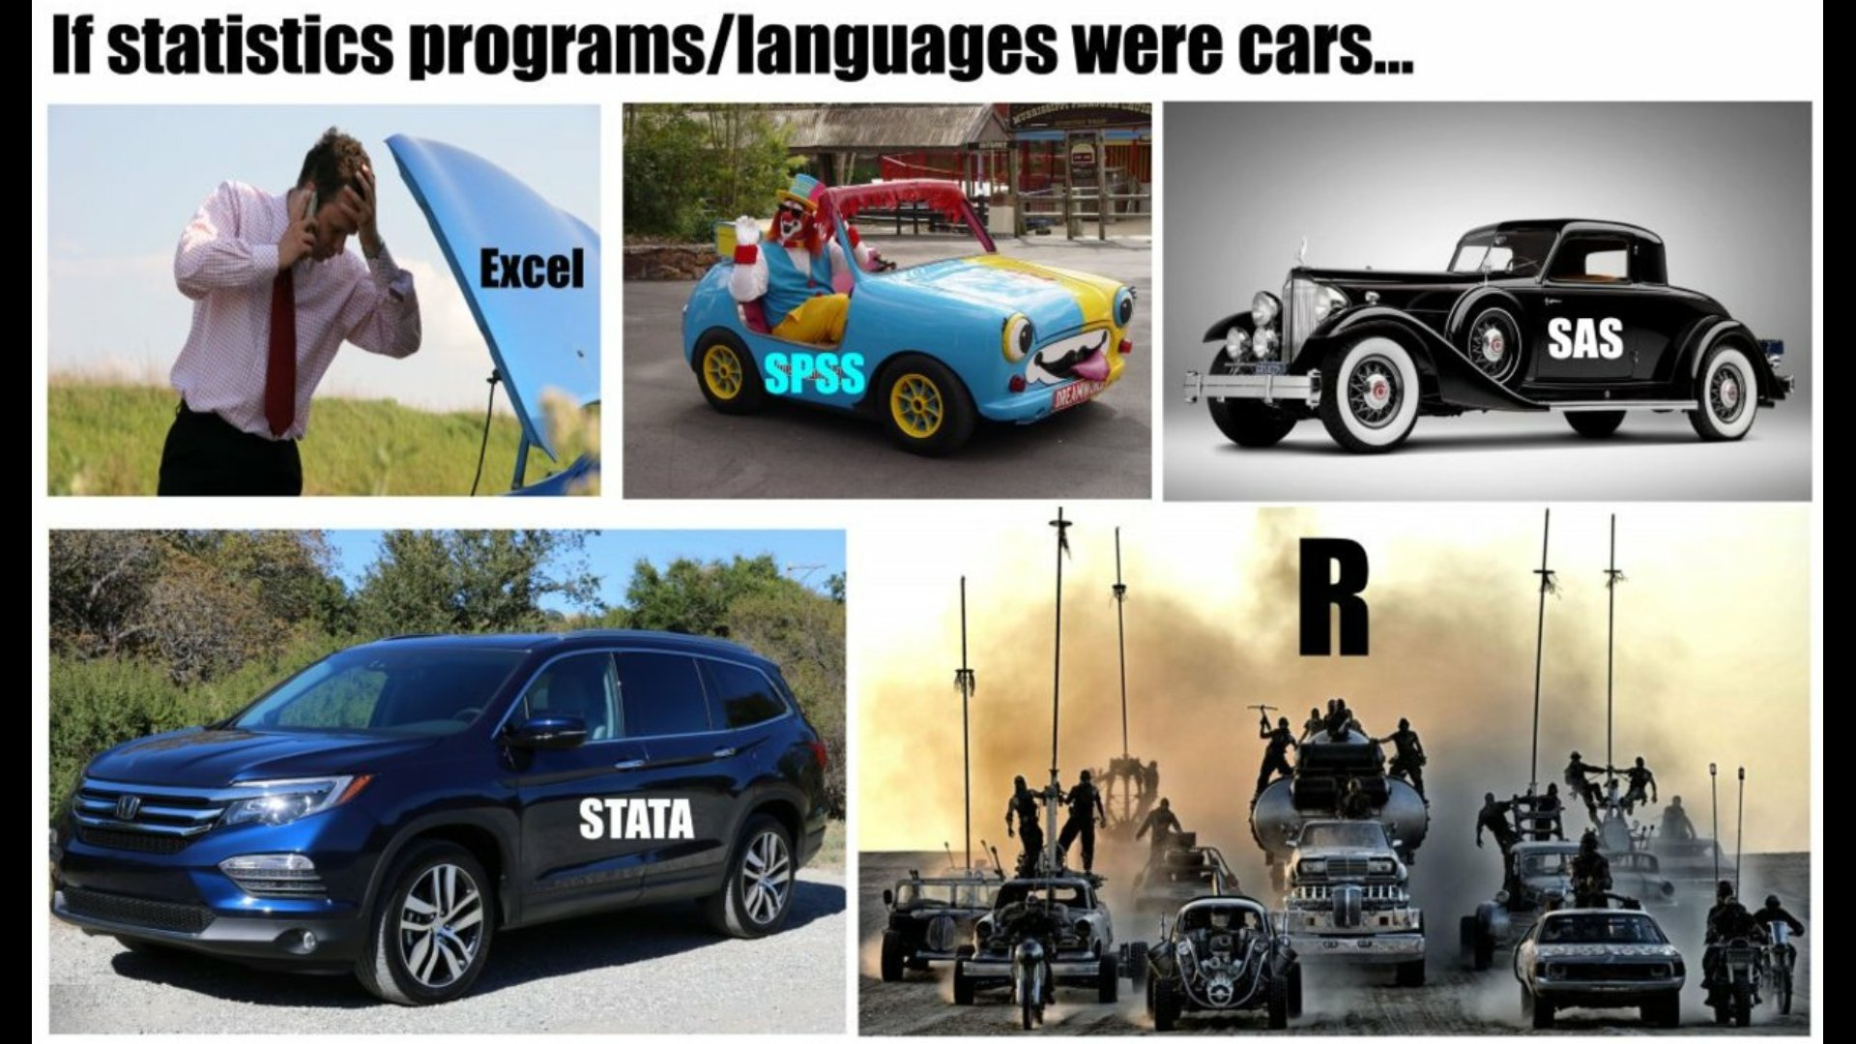
Why learn R? – opportunity cost.

Slide 11
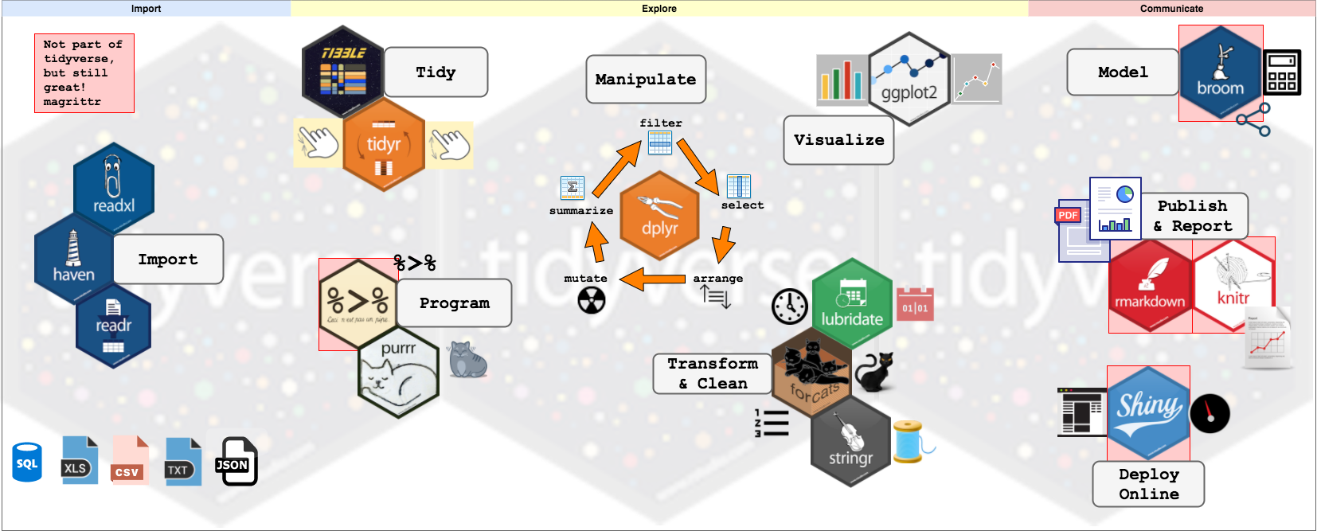
Why learn R? – flexibility
Notes:
R – PACKAGE FOR STATISTICS!!!!!!!!

Slide 12

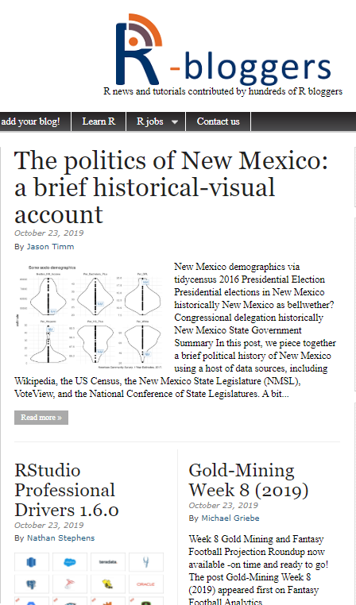
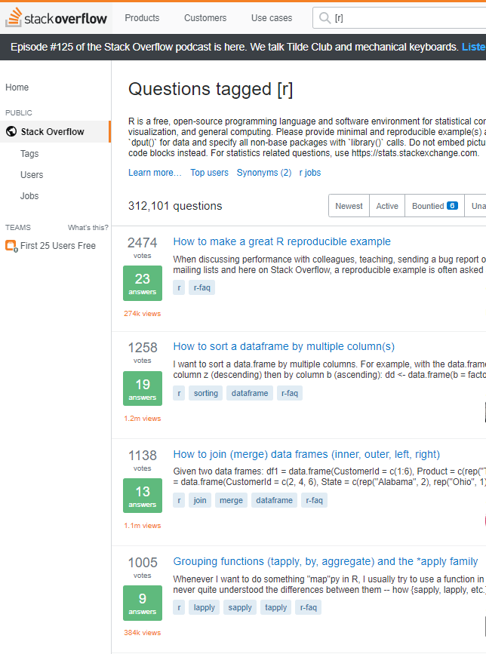
Why learn R? – community.
https://r4ds.had.co.nz/

Slide 13
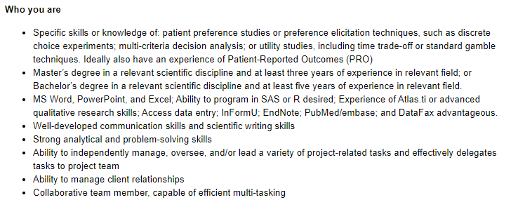

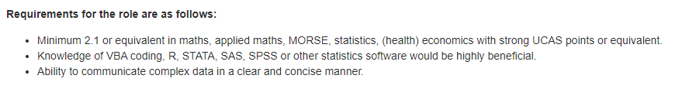
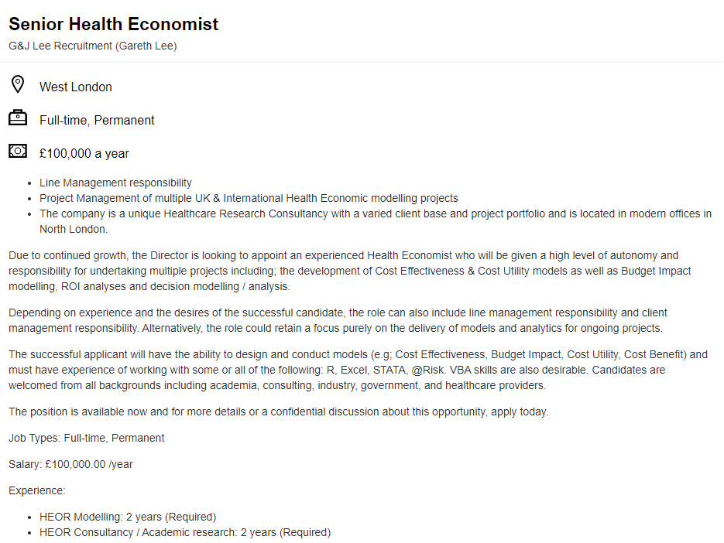

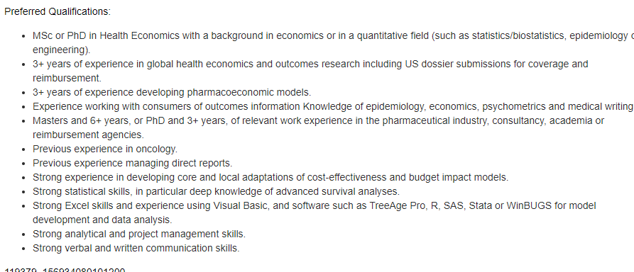
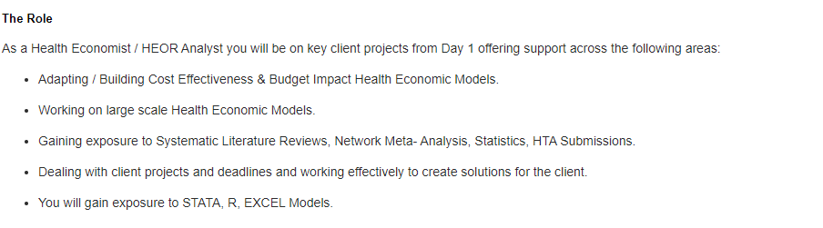
Why learn R? – employability

Slide 14
Additional Features

Slide 15


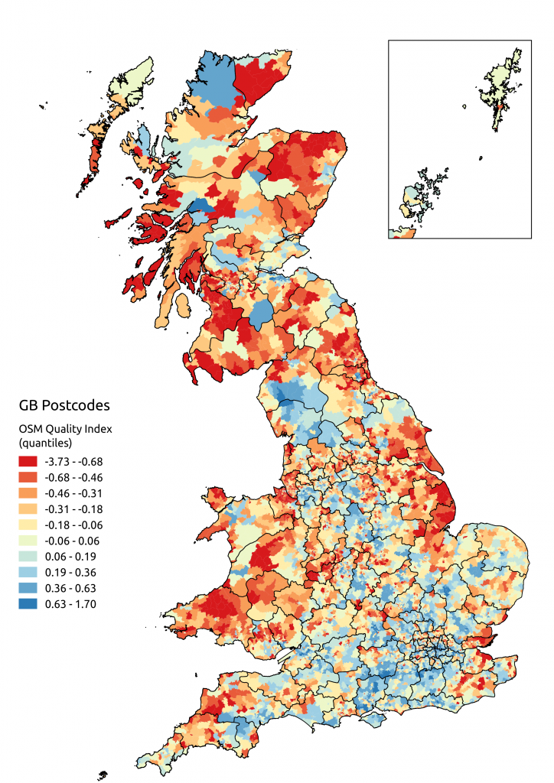
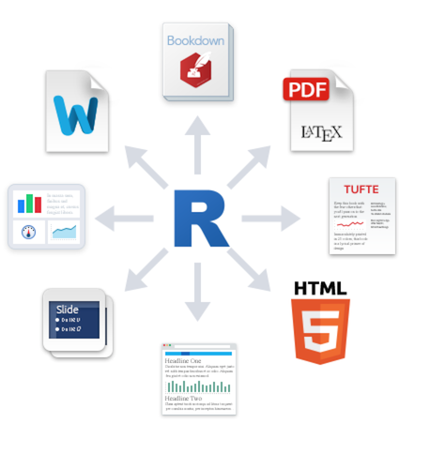
Course Document
Link to graph gallery
Course Document

Slide 16


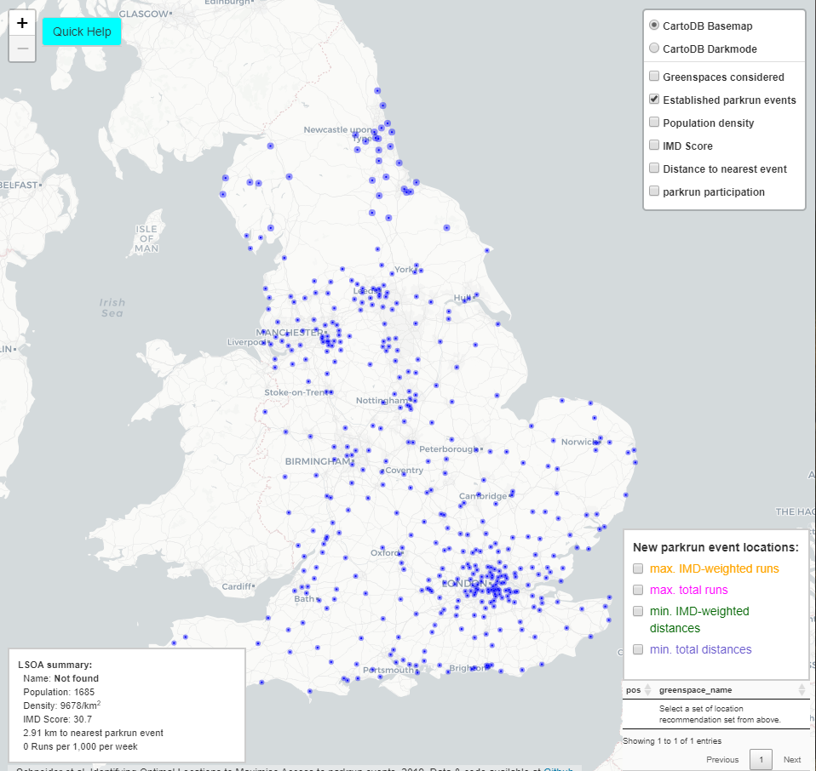
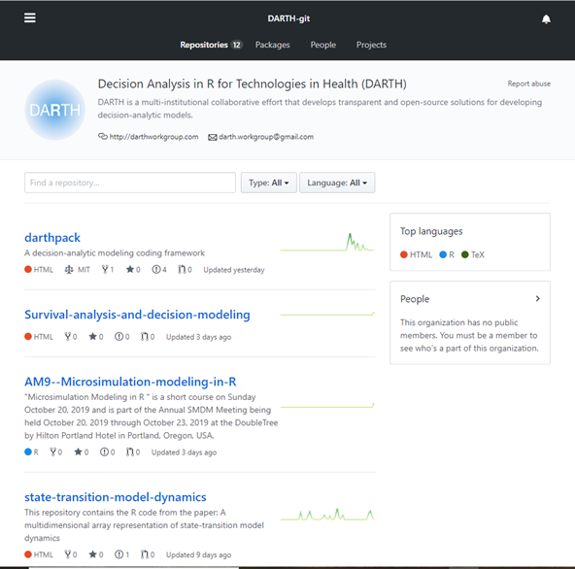
http://iol-map.shef.ac.uk/
https://github.com/DARTH-git

Slide 17
My experience learning R

Slide 18
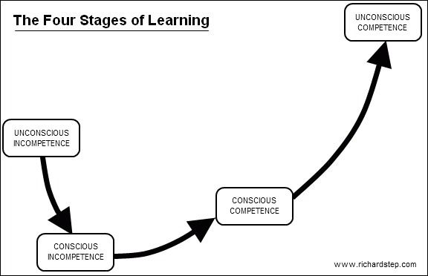

Slide 19
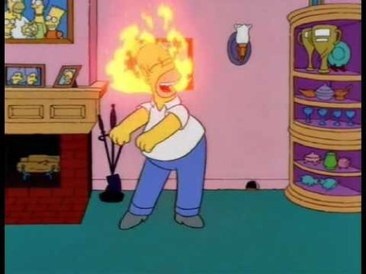

Slide 20
Session 1

Slide 21
Session 1: Objectives
Learn how to navigate R-Studio.
Learn how to use R to perform basic calculations
Learn what objects are and where they are stored.
Perform basic evaluations.

Slide 22
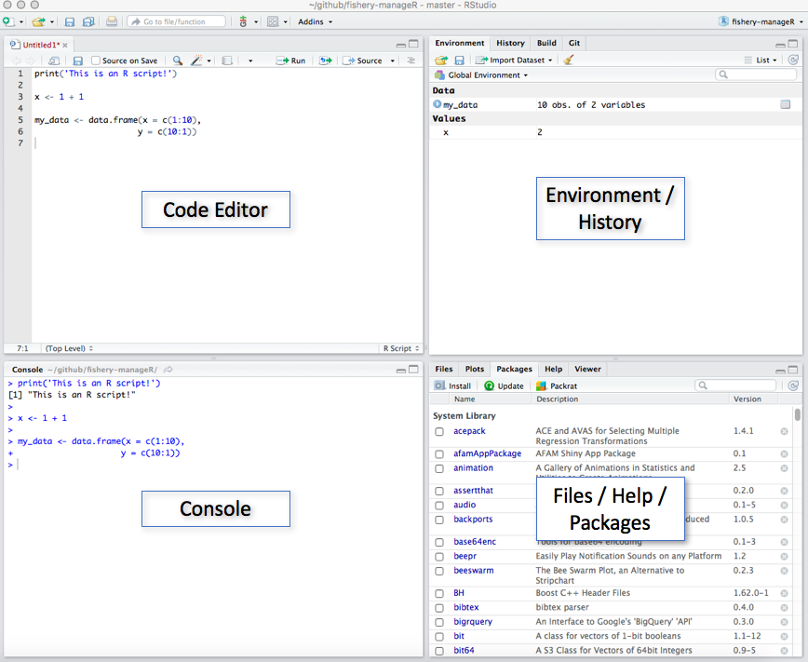
Session 1: R-Studio Layout

Slide 23


Slide 24
<insert Exercises link>

Slide 25
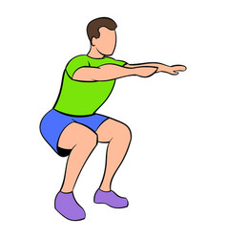

10 minute break

Slide 26
Session 2

Slide 27
Session 2: Objectives
Know what classes objects can take.
Understand the different object types.
Have the ability to subset objects.
Understand common errors when working with different object classes and types.

Slide 29

<insert Exercises link> Any questions, feel free to comment on the chat.

Slide 31

10 minute break

Slide 32
Session 3

Slide 33
Session 3: Objectives
Know how to read in data from different file types.
Understand how to sense-check datasets.
Summarize data.
Create basic plots.

Slide 35
<insert Exercises link>

Slide 36
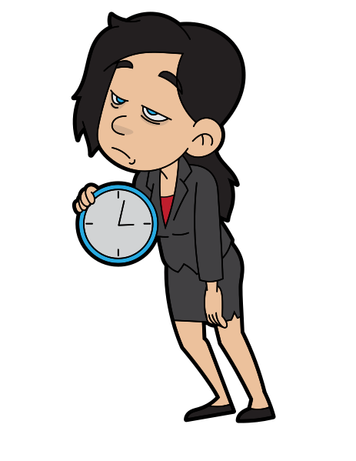
Exercises Finished

Slide 37
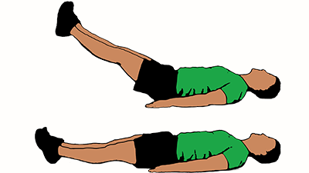
10 minute break

Slide 38
Conclusion Presentation

Slide 39
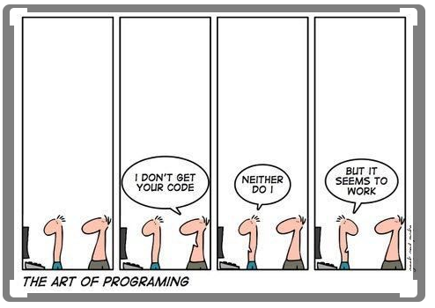
Live coding

Slide 40
Further resources

Slide 41
Final Questions

